Slide 1

WIPRO NGA Program – 24NAG0970 EP-Java Full Stack
Capstone Project Presentation – 11 JULY 2024
Project Title Here – Medical Billing and Claiming Management System
Presented by – Irrinki. Prakash Manikanta
Maddula Rupa Sri Manohar
Mohammad Firoze Baba
Munaga Manasa
www.rpsconsulting.in
Trained By - Javeed

Slide 2

Contents
Abstract
Scope
Technologies
Usecase Diagram
Modules
Codes
Results
Conclusion
2024 - RPS Consulting all rights reserved

Slide 3
Abstract
The Medical Billing and Claims Management System is a comprehensive application designed to streamline the intricate process of medical billing, claims submission, and reimbursement. It aims to reduce administrative burdens, enhance accuracy, and improve communication between healthcare providers, insurance companies, and patients. The system facilitates efficient claims submission by healthcare providers, enables insurance companies to process claims, validate coverage and generates and manages patient invoices based on medical services and insurance coverage. Additionally, it ensures data privacy through user authentication and authorization mechanisms​.
2024 - RPS Consulting all rights reserved

Slide 4
Scope
Efficient Claims Submission:
Develop a system for healthcare providers to submit accurate and timely insurance claims.
Claims Processing:
Enable insurance companies to process claims, validate coverage, and reimburse healthcare providers.
Patient Invoicing:
Generate and manage invoices for patients based on their medical services and insurance coverage.
Patient Enrollment and Insurance Management:
Facilitate patient registration, profile creation, and insurance plan selection.
Allow patients to submit claims electronically from their dashboard.
Healthcare Service and Billing:
Enable healthcare providers to log in, add details of services rendered, and generate electronic invoices.
Claim Submission and Processing:
Allow patients to submit claims electronically with relevant medical documents.
Enable insurance companies to review, approve, or reject claims and initiate payments for approved claims.
2024 - RPS Consulting all rights reserved

Slide 5
Technologies Used In This Project
1. Java
2. Spring Boot
3. MySql
4. Angular
5. HTML, CSS, Bootstrap
6. Maven
7. Spring Data JPA
2024 - RPS Consulting all rights reserved

Slide 6
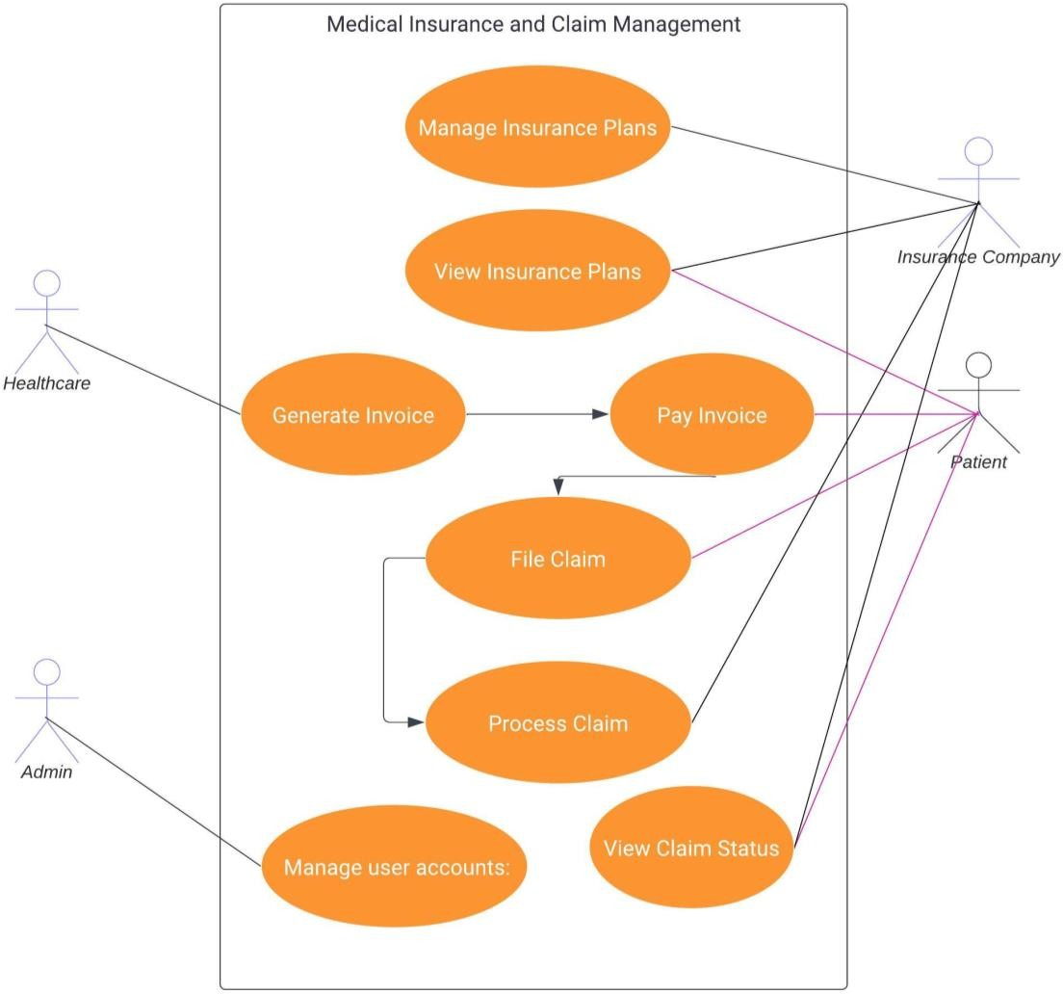
Use Case Diagram:
2024 - RPS Consulting all rights reserved

Slide 7
Patient Usecase
Detailed View of Patient
2024 - RPS Consulting all rights reserved

Slide 8
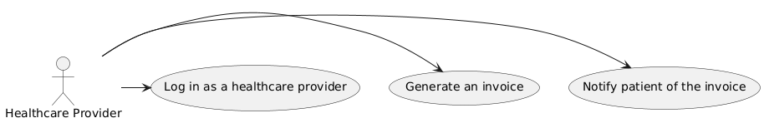
Healthcare Provider Usecase
Detailed View of Healthcare Provider
2024 - RPS Consulting all rights reserved

Slide 9
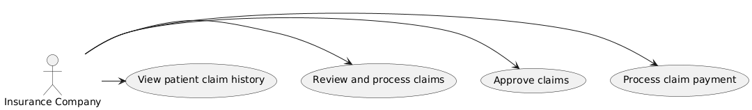
Insurance Company Usecase
Detailed View of Insurance Company
2024 - RPS Consulting all rights reserved

Slide 10
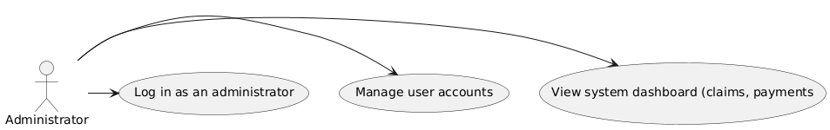
Administrator Usecase
Detailed View of Admin
2024 - RPS Consulting all rights reserved

Slide 11
Modules
Patient Module:
Patient Enrollment and Insurance Management:
Registration and Profile Creation
Insurance Plan Search and Selection
Invoice Generation Request
Claim Request
2024 - RPS Consulting all rights reserved

Slide 12
Modules
Healthcare Module:
Healthcare Service and Billing:
Provider Login and Service Details Entry
Electronic Invoice Generation
Invoice Status Update
Claim Form Submission
2024 - RPS Consulting all rights reserved

Slide 13
Modules
Claim Submission Module:
Claim Submission and Processing:
Electronic Claim Submission
Claim Review and Processing
Claim History
2024 - RPS Consulting all rights reserved

Slide 14
Modules
Admin Module:
Administrator Dashboard:
System Access and Dashboard View
Claim Details History
User Account Management
2024 - RPS Consulting all rights reserved

Slide 15
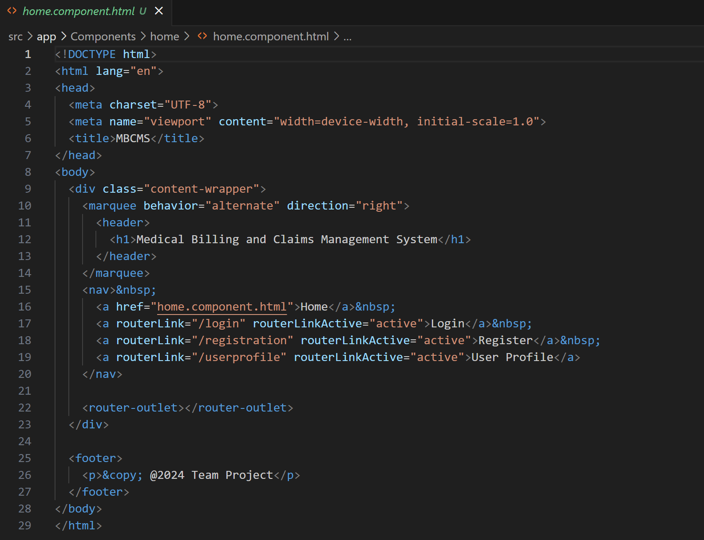
Home
2024 - RPS Consulting all rights reserved

Slide 16
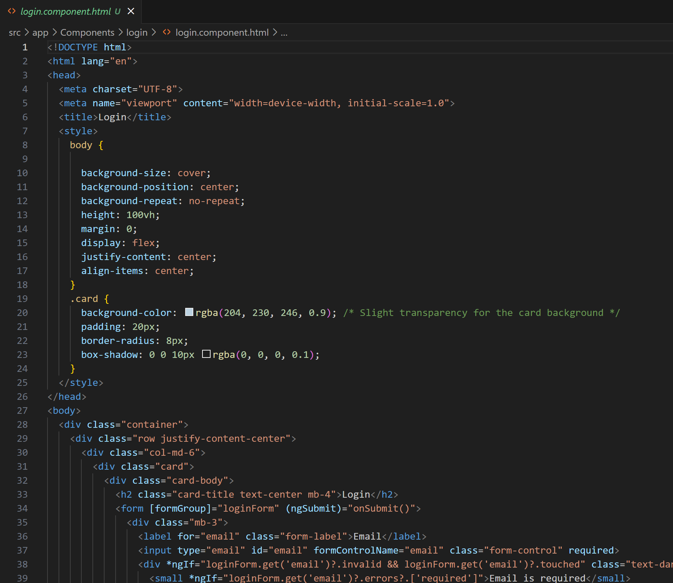
Login
2024 - RPS Consulting all rights reserved

Slide 17
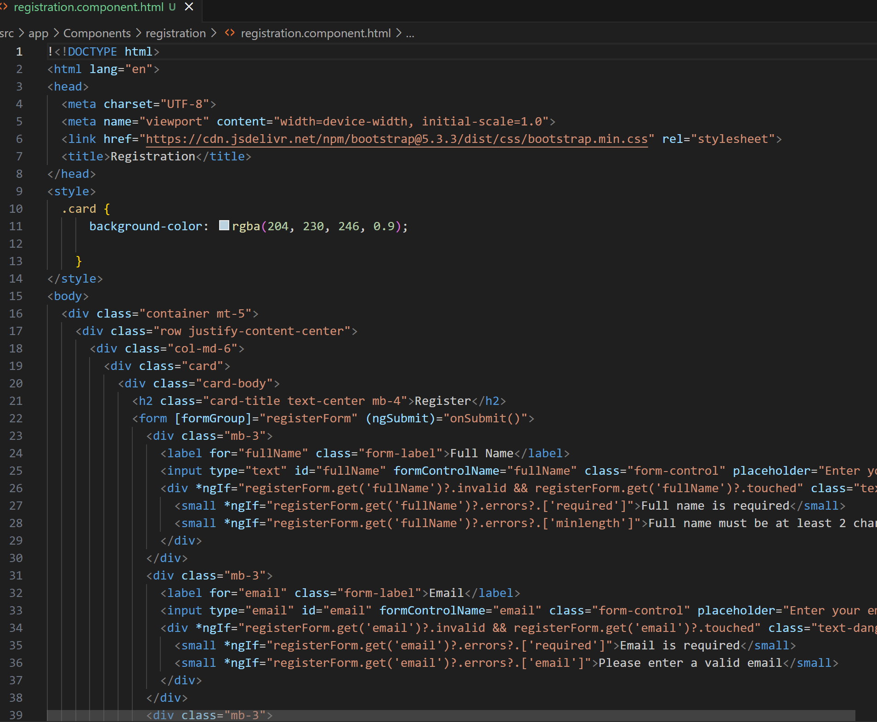
Registration
2024 - RPS Consulting all rights reserved

Slide 18
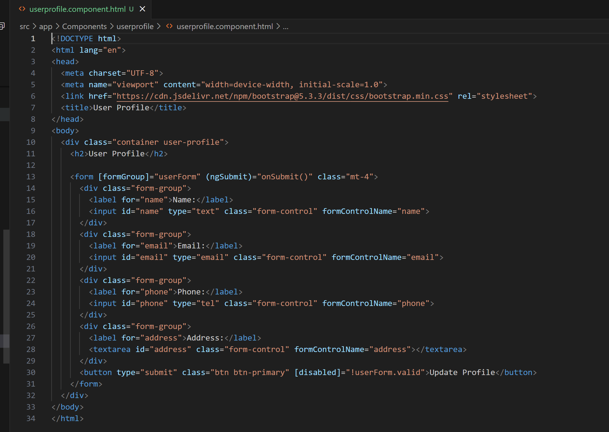
User Profile
2024 - RPS Consulting all rights reserved

Slide 19
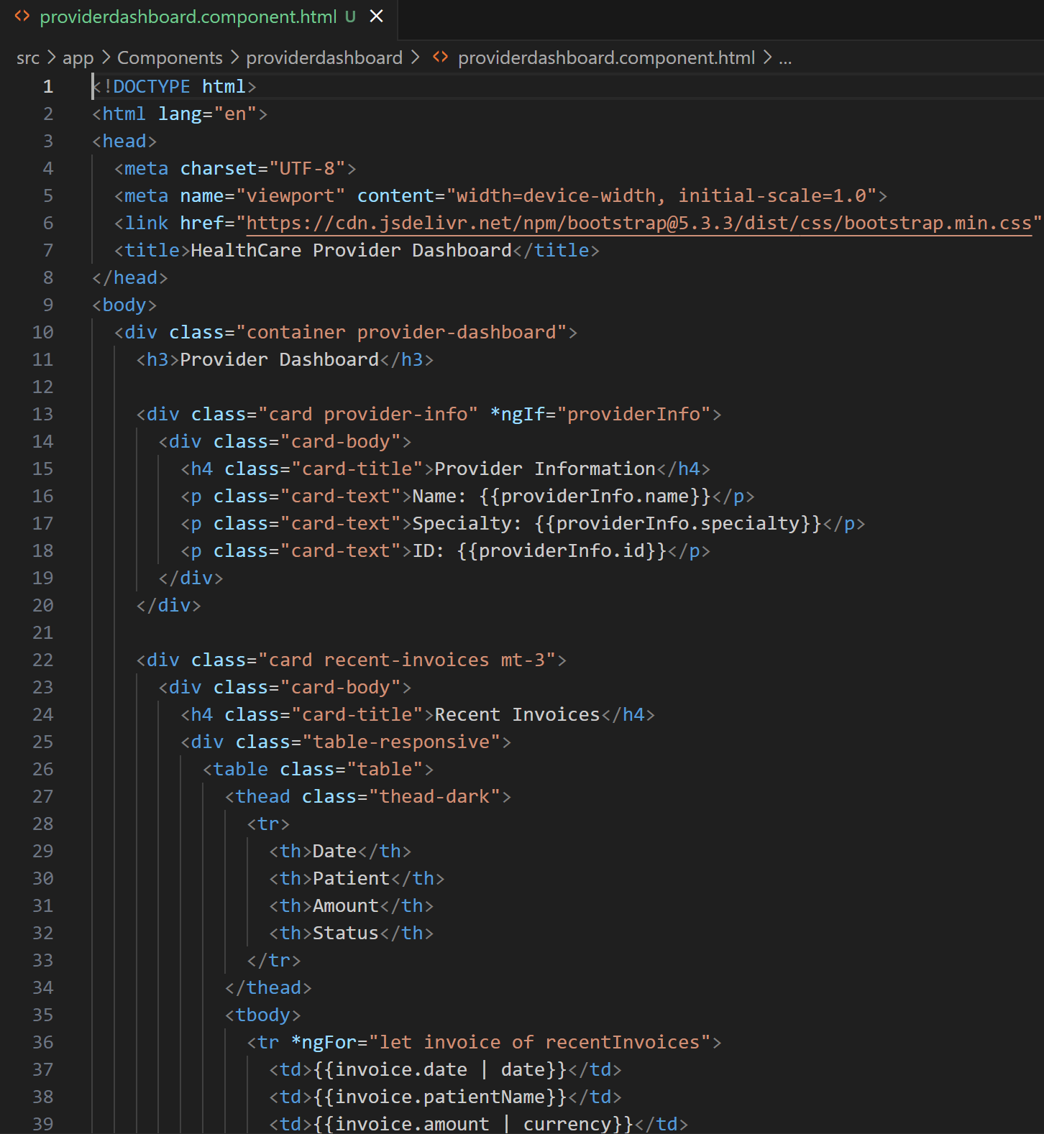
Provider DashBoard
2024 - RPS Consulting all rights reserved

Slide 20
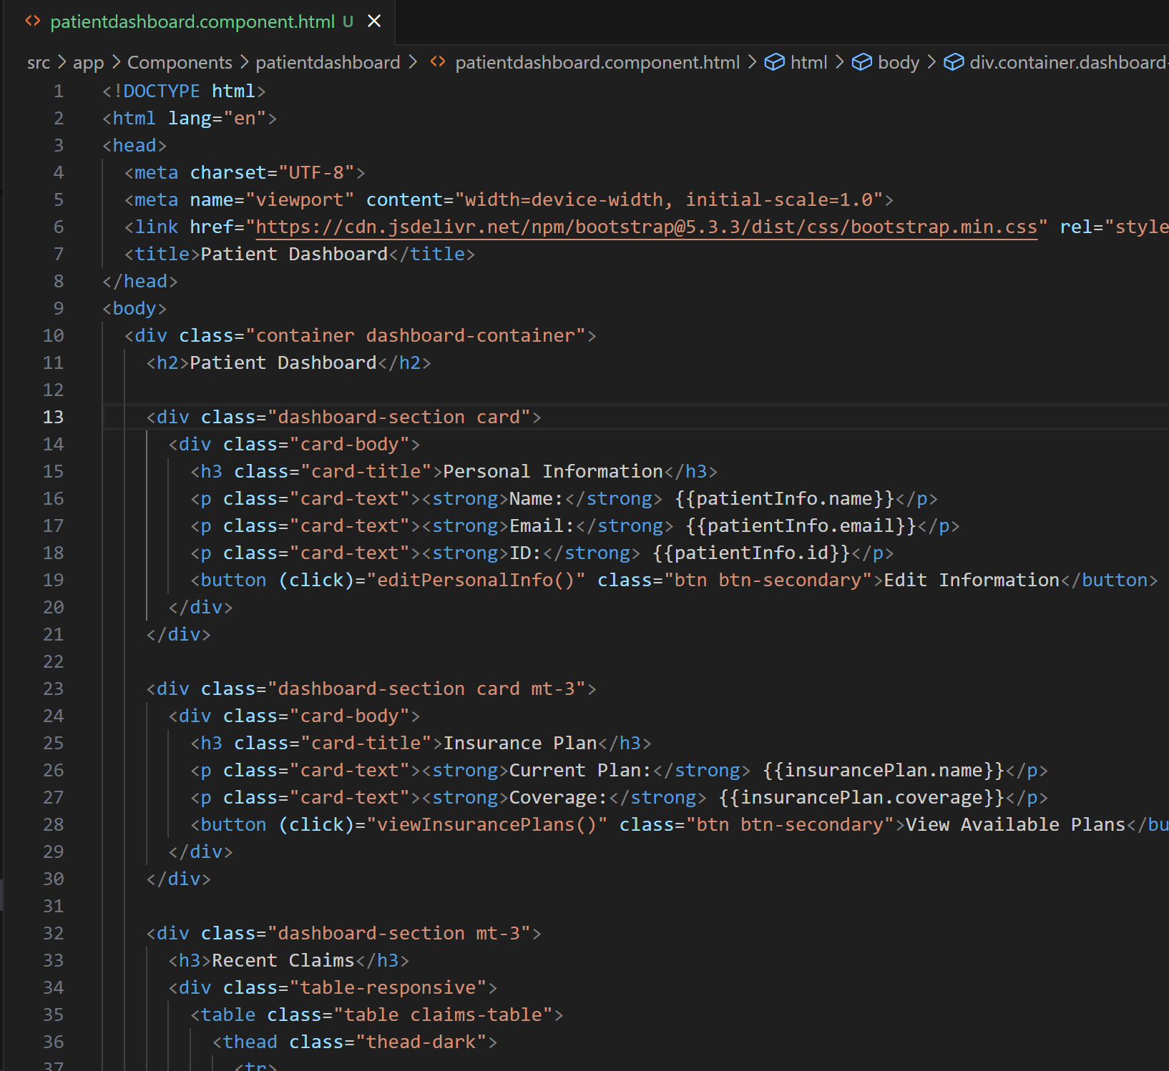
Patient DashBoard
2024 - RPS Consulting all rights reserved

Slide 21
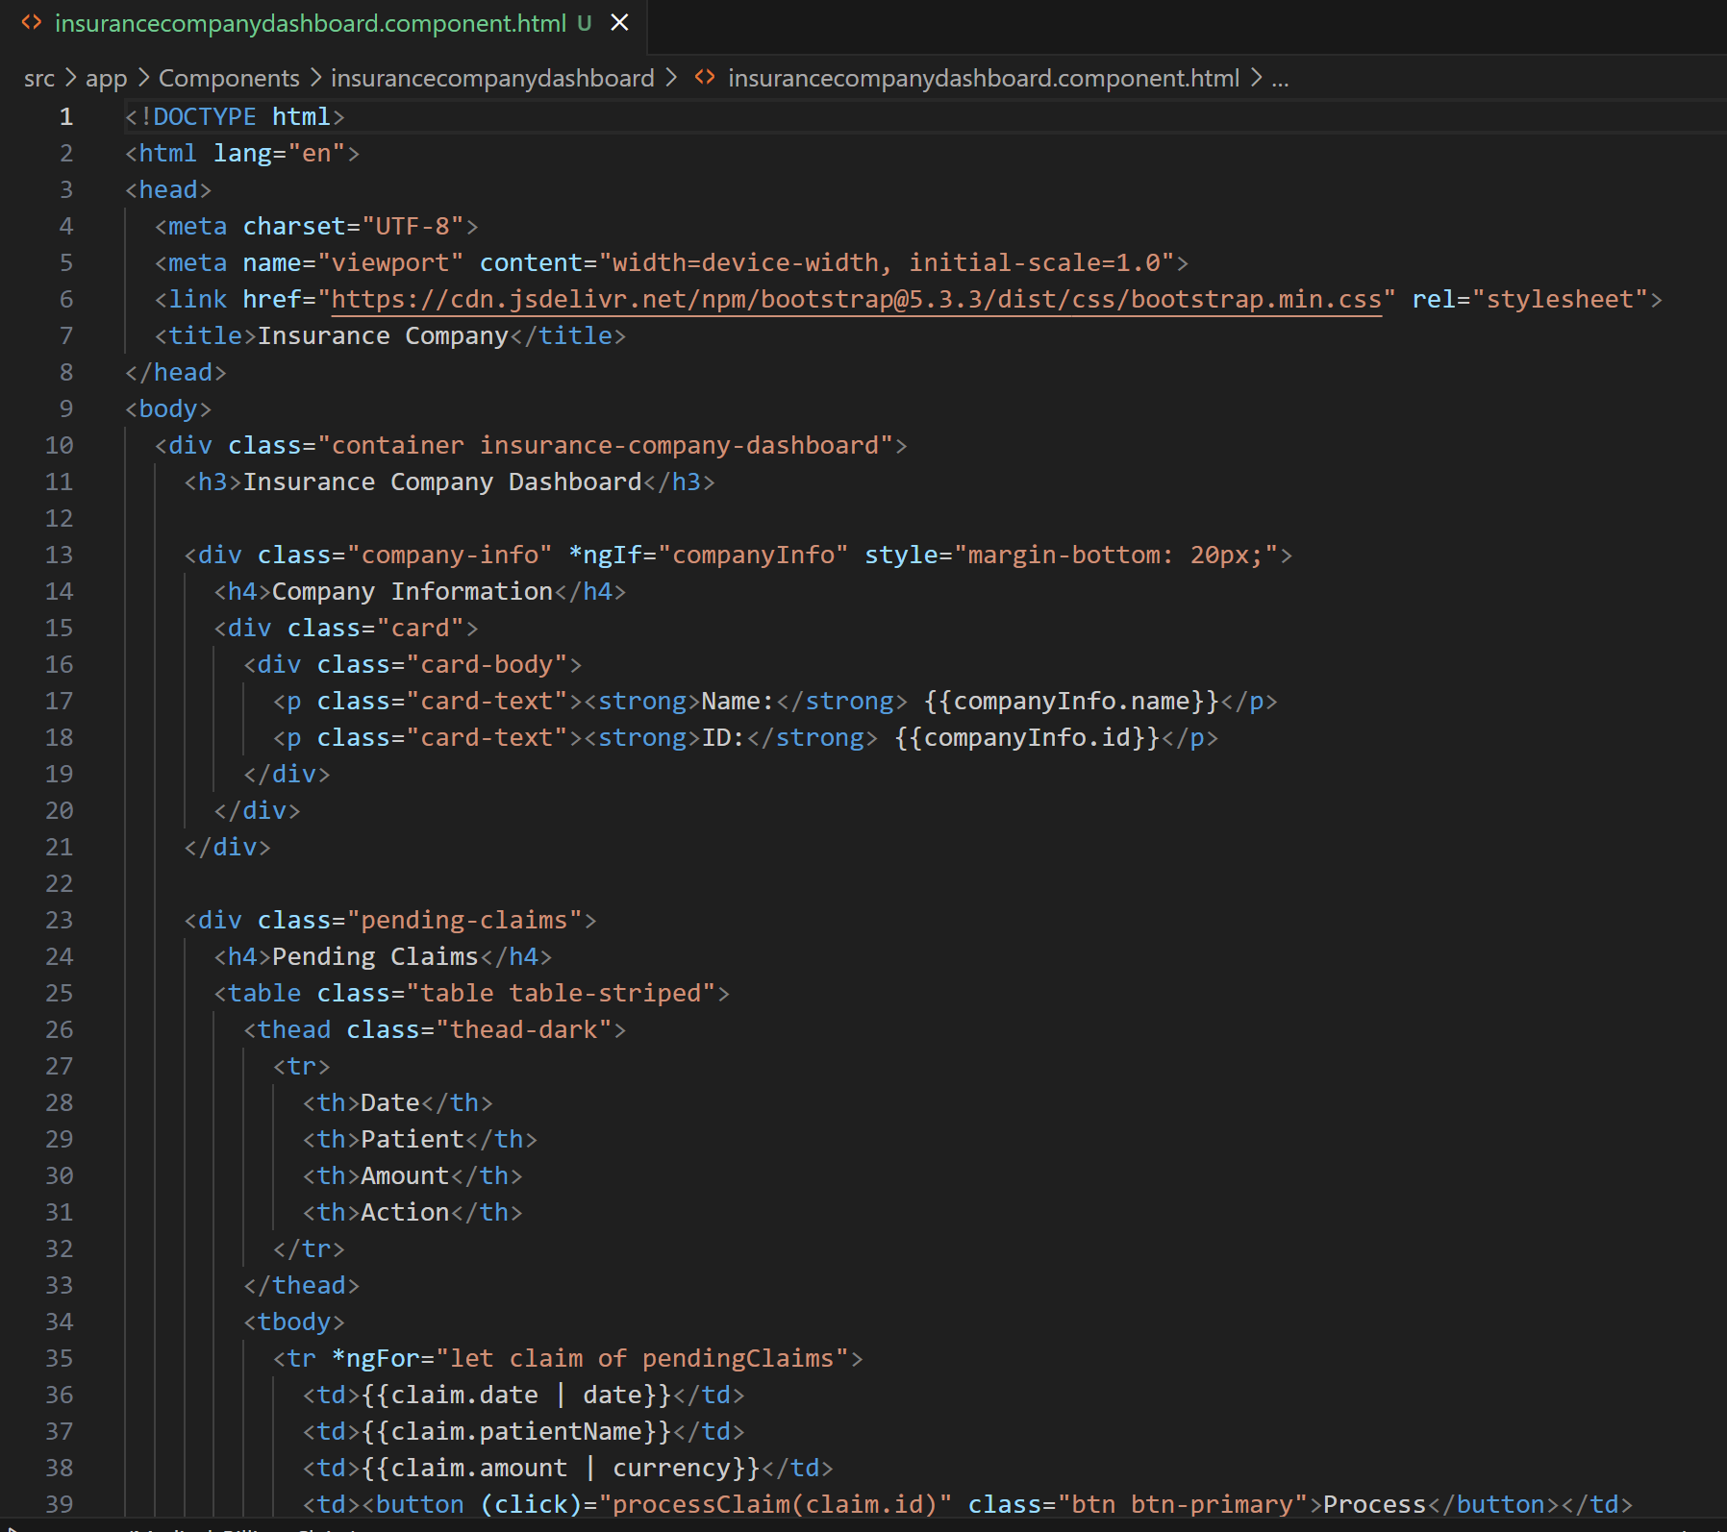
Insurance Company Dashboard
2024 - RPS Consulting all rights reserved

Slide 22
Insurance Plan Selection
2024 - RPS Consulting all rights reserved

Slide 23
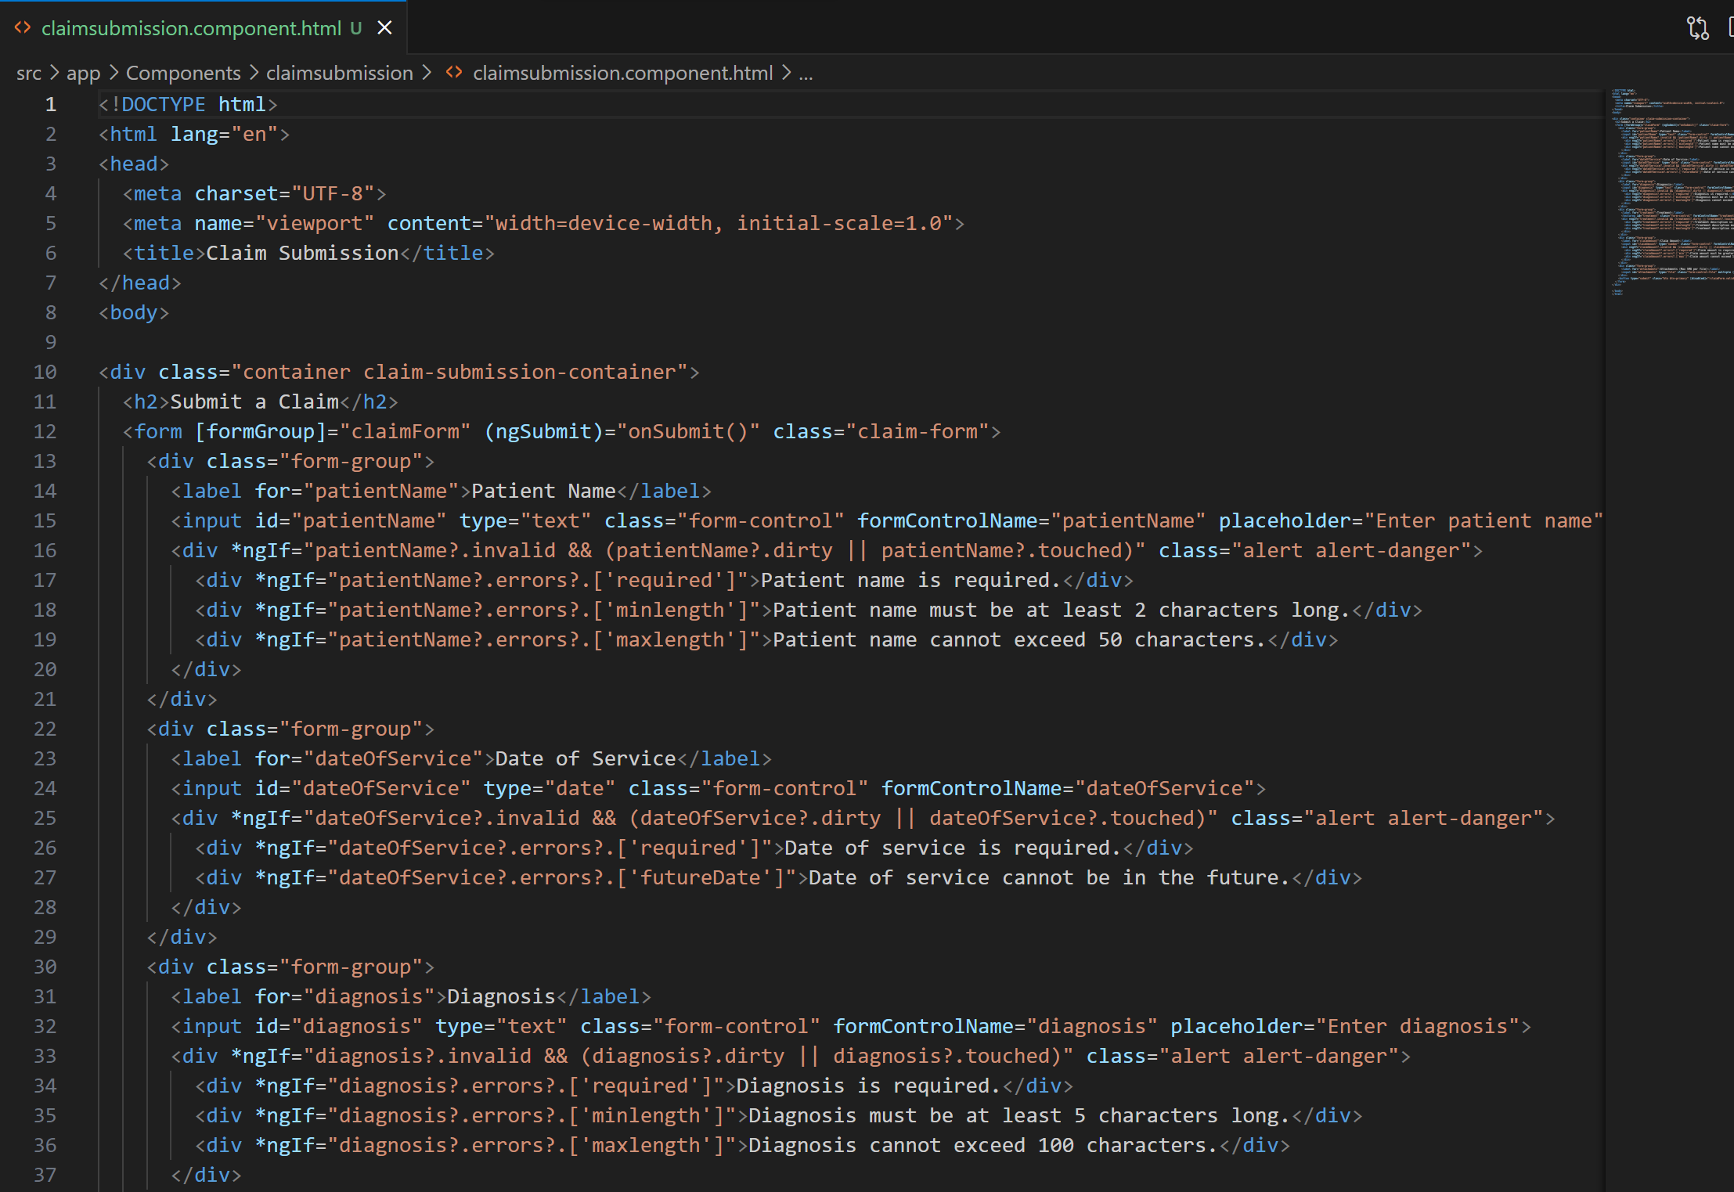
Claim Submission Code
2024 - RPS Consulting all rights reserved

Slide 24
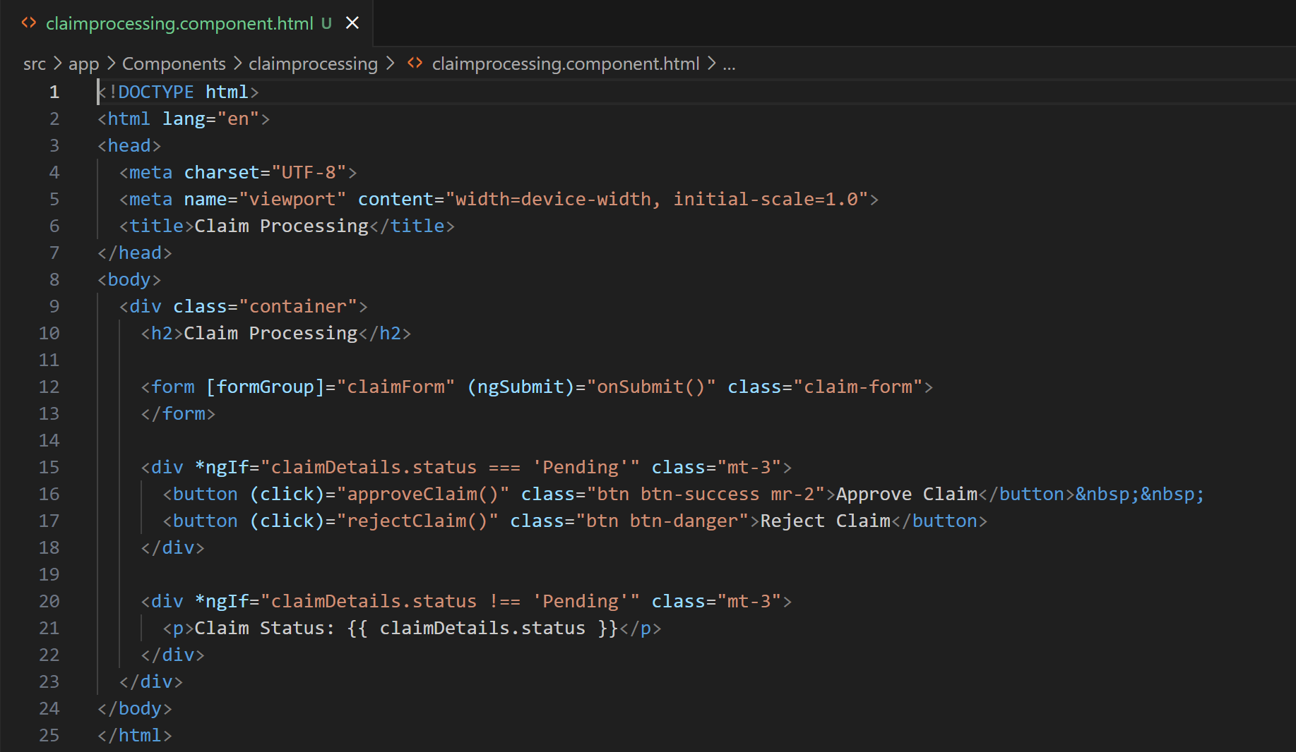
Claim Processing Code
2024 - RPS Consulting all rights reserved

Slide 25
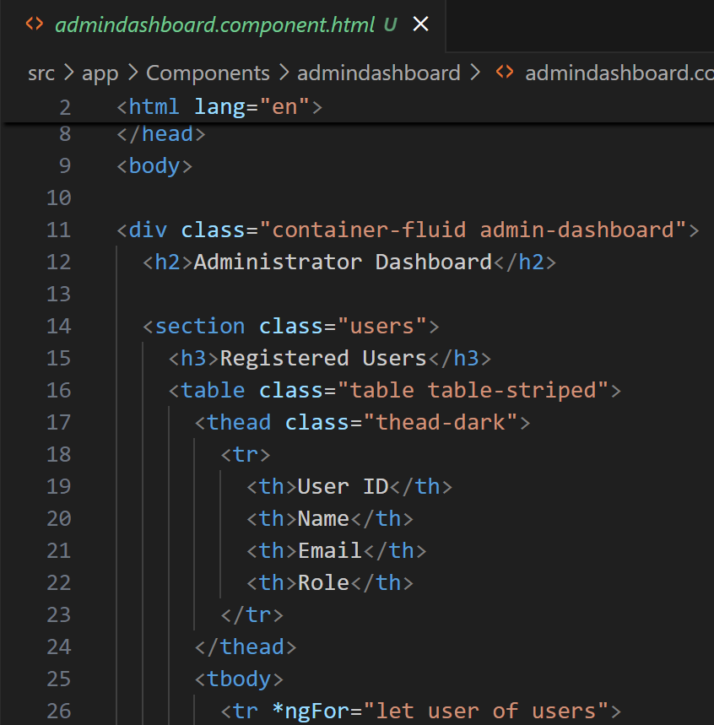
Admin Dashboard Code
2024 - RPS Consulting all rights reserved

Slide 26
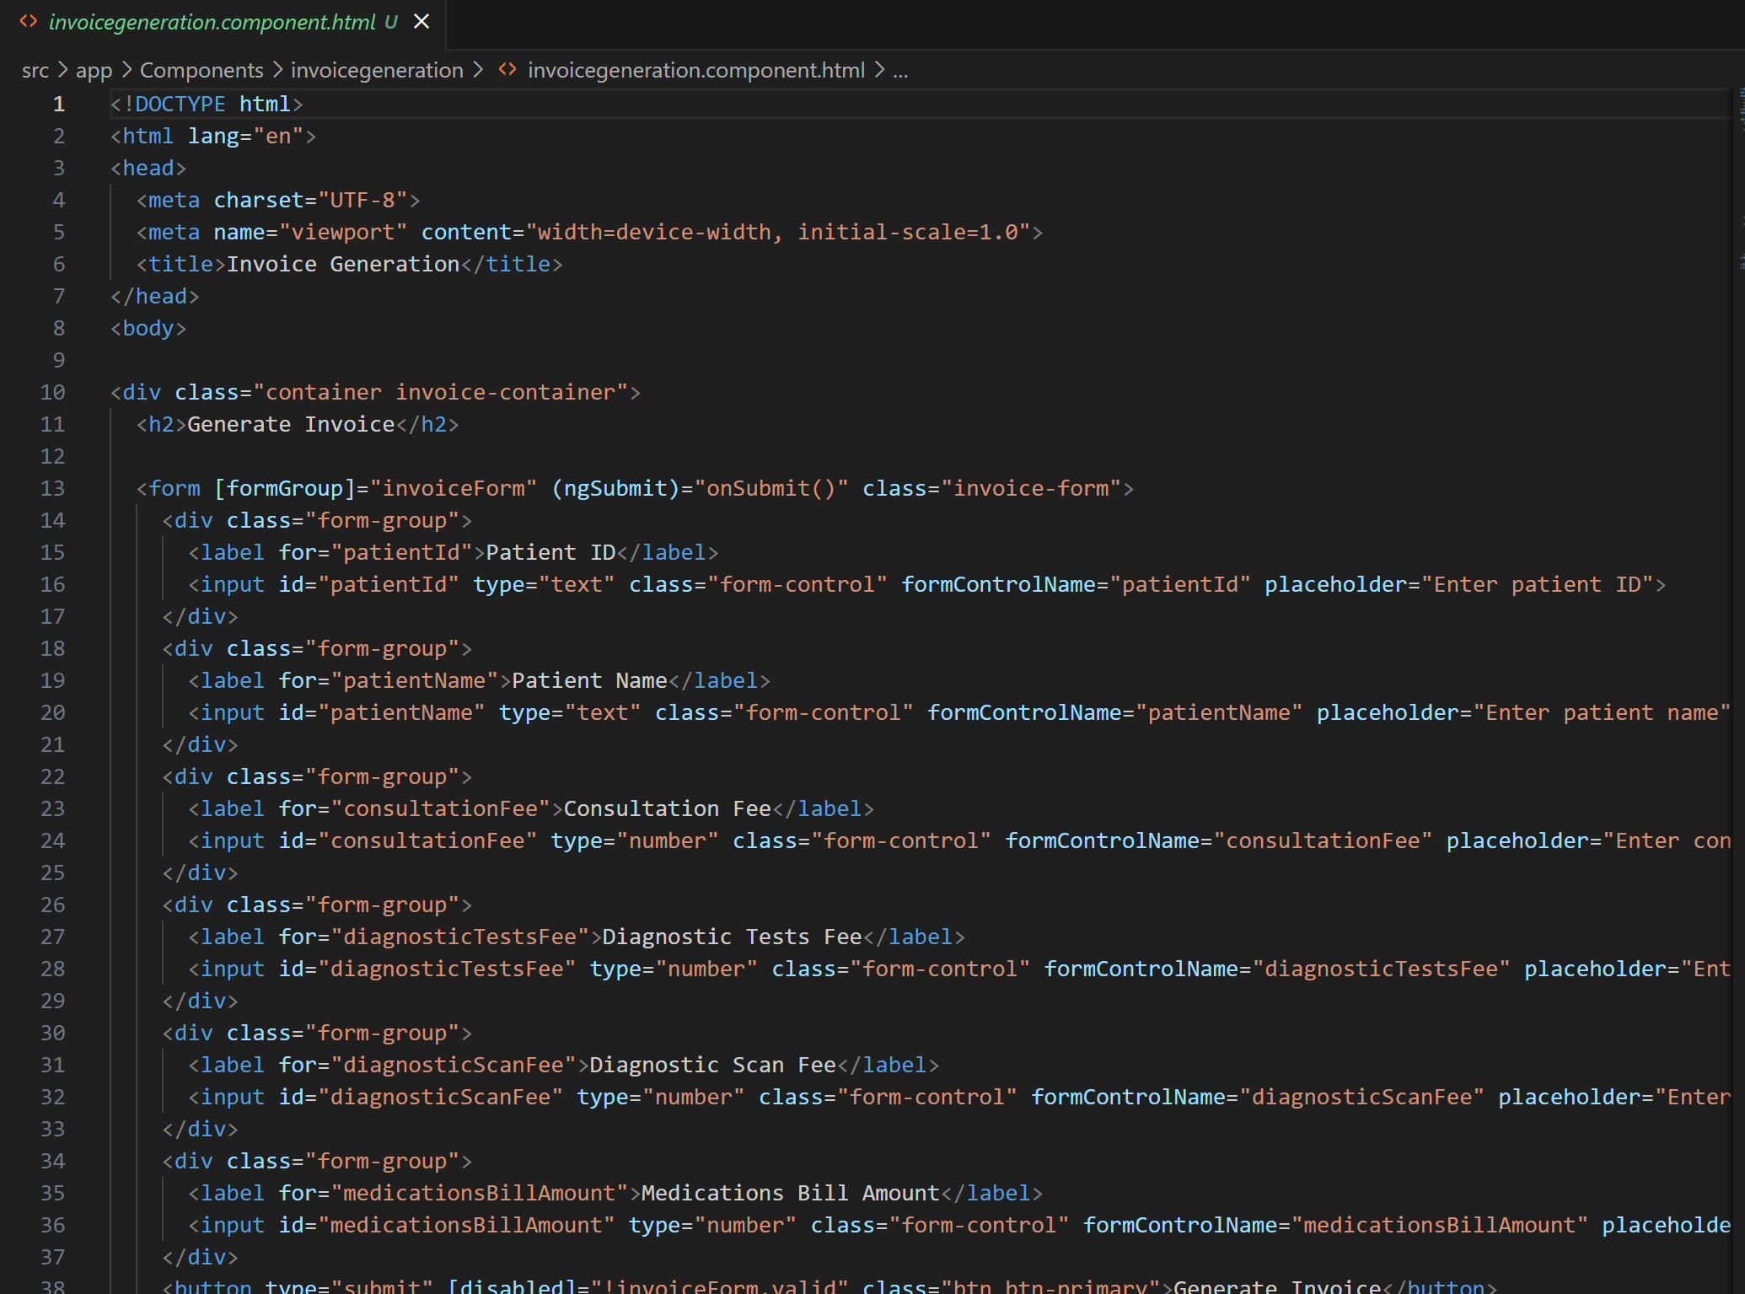
Invoice Generation
2024 - RPS Consulting all rights reserved

Slide 27
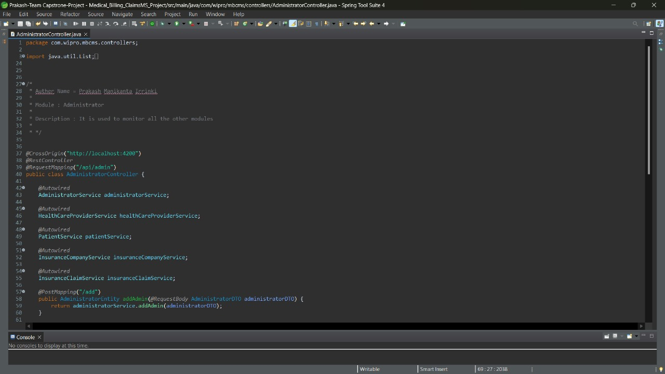
Administrator Controller
2024 - RPS Consulting all rights reserved

Slide 28
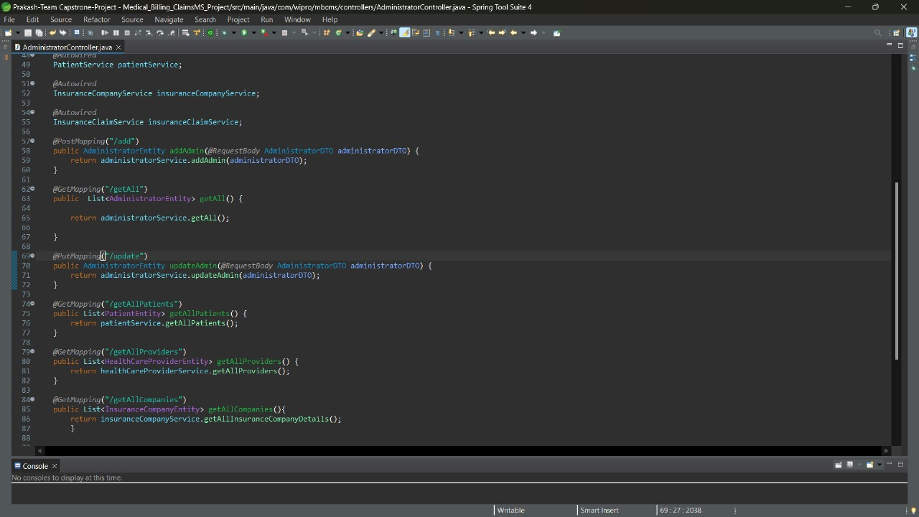
Administrator Controller
28
2024 - RPS Consulting all rights reserved

Slide 29
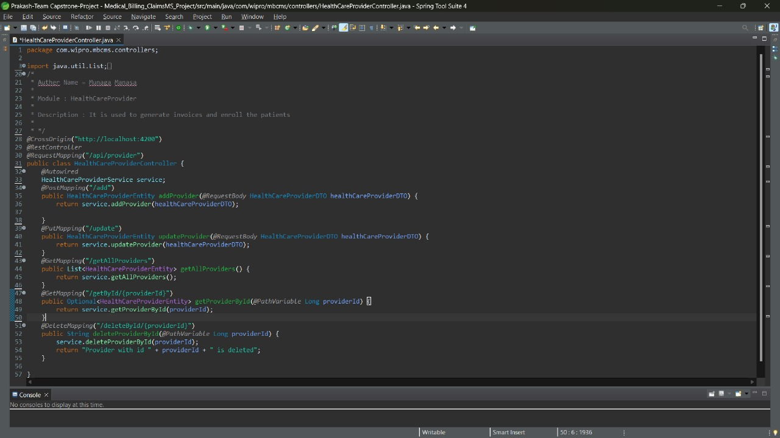
Health Care Provider Controller
29
2024 - RPS Consulting all rights reserved

Slide 30
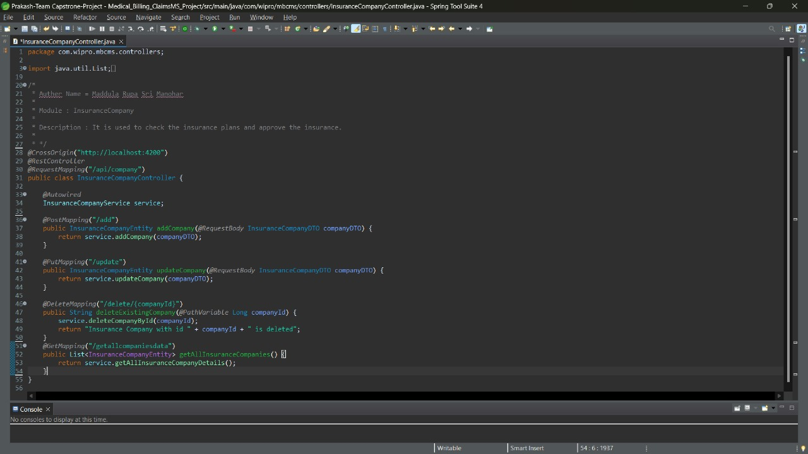
Insurance company Controller
30
2024 - RPS Consulting all rights reserved

Slide 31

Patient Controller
31
2024 - RPS Consulting all rights reserved

Slide 32
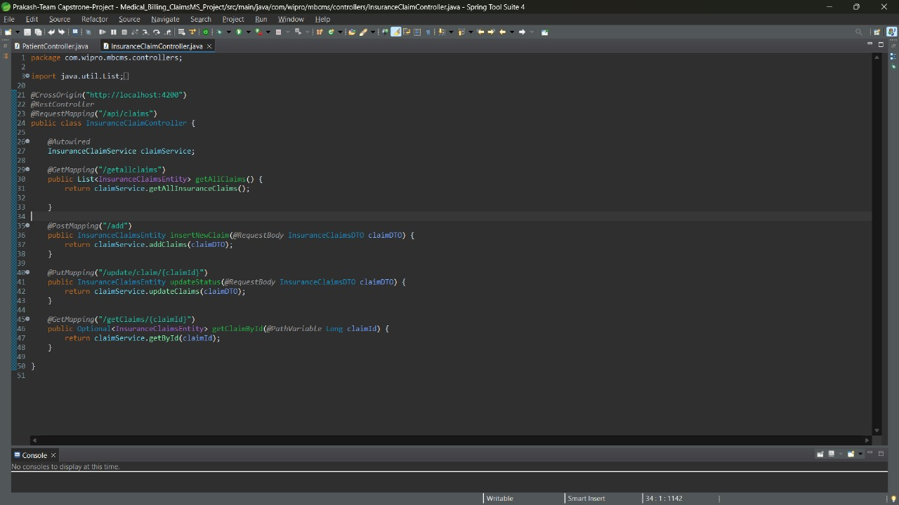
Insurance Claim Controller
32
2024 - RPS Consulting all rights reserved

Slide 33

Invoice Controller
33
2024 - RPS Consulting all rights reserved

Slide 34
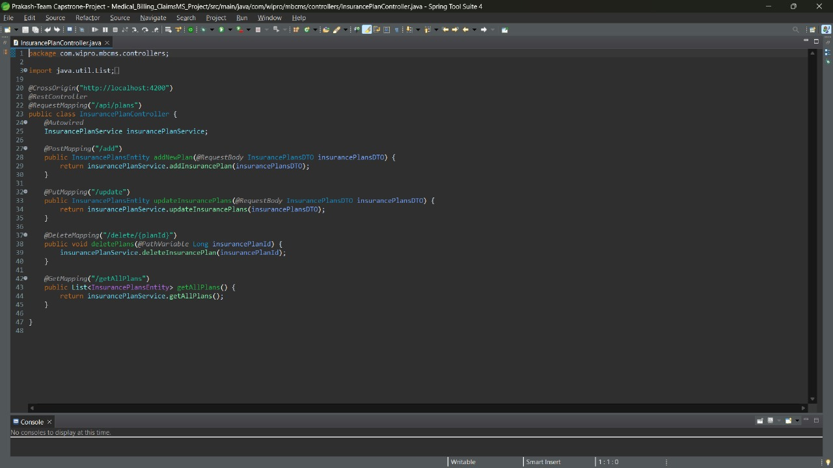
Insurance Plan Controller
34
2024 - RPS Consulting all rights reserved

Slide 35
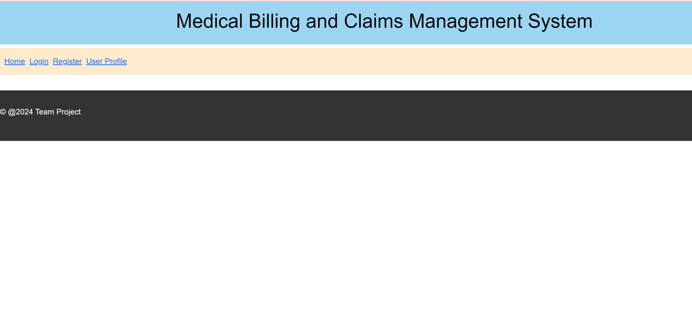
Home Page
2024 - RPS Consulting all rights reserved

Slide 36
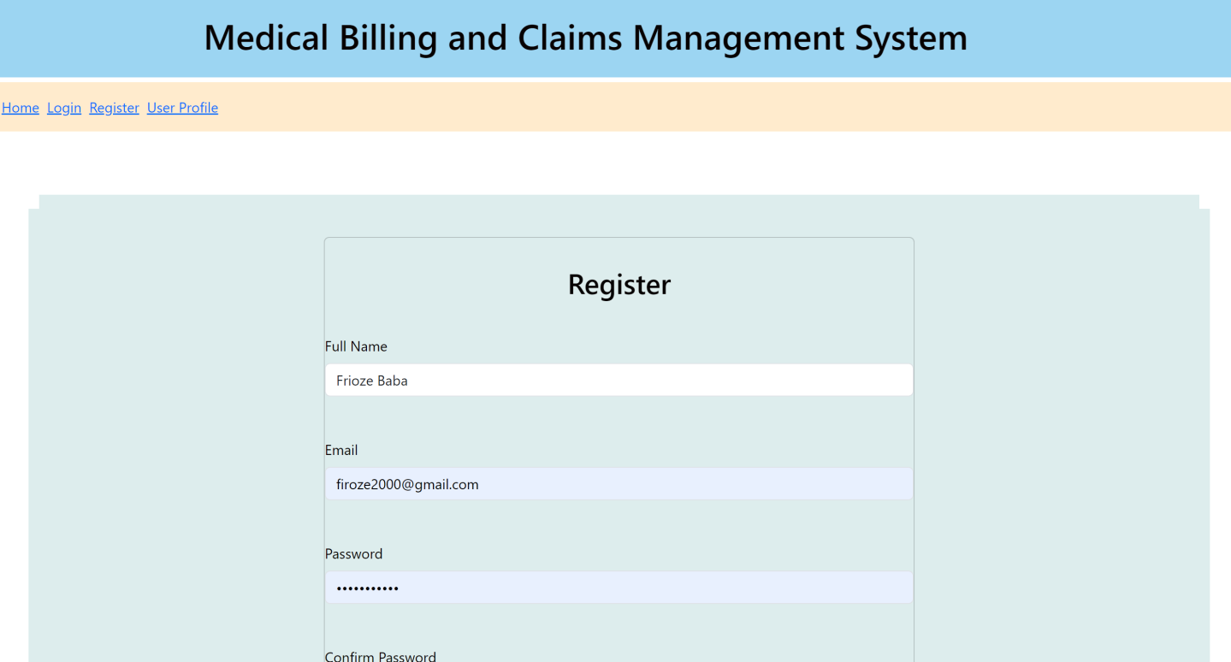
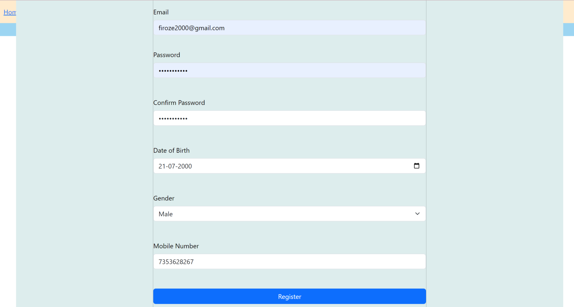
Register Page :
2024 - RPS Consulting all rights reserved

Slide 37
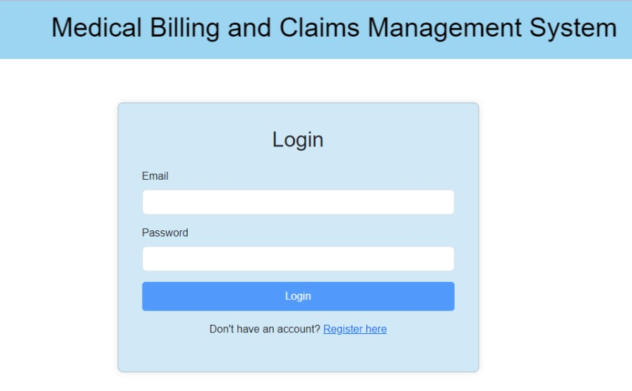
Login Page
2024 - RPS Consulting all rights reserved

Slide 38
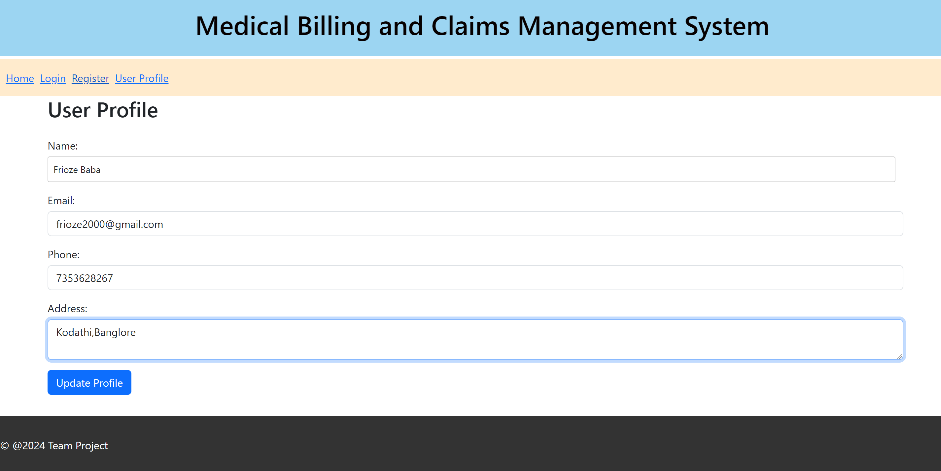
User Profile
2024 - RPS Consulting all rights reserved

Slide 39
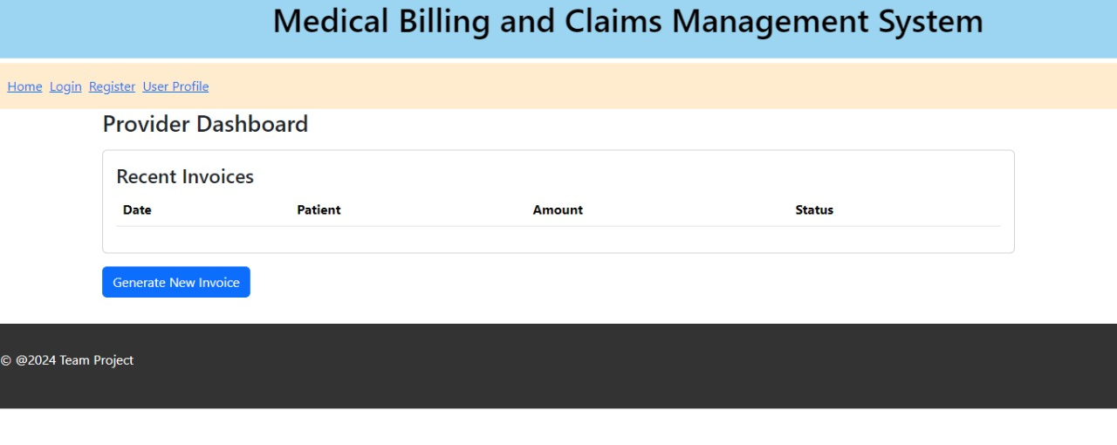
Provider Dashboard
2024 - RPS Consulting all rights reserved

Slide 40
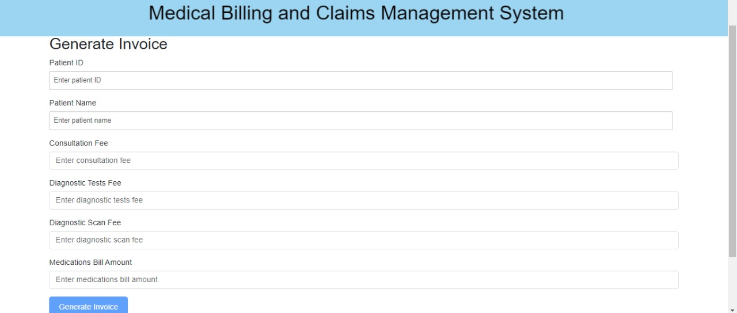
Generate Invoice
2024 - RPS Consulting all rights reserved

Slide 41
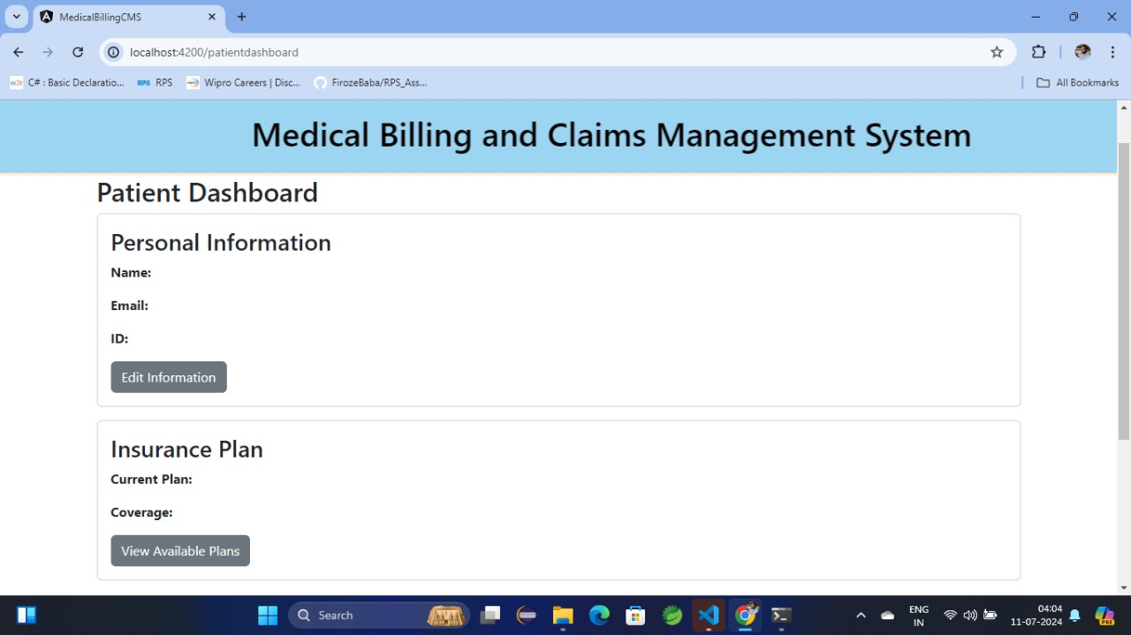
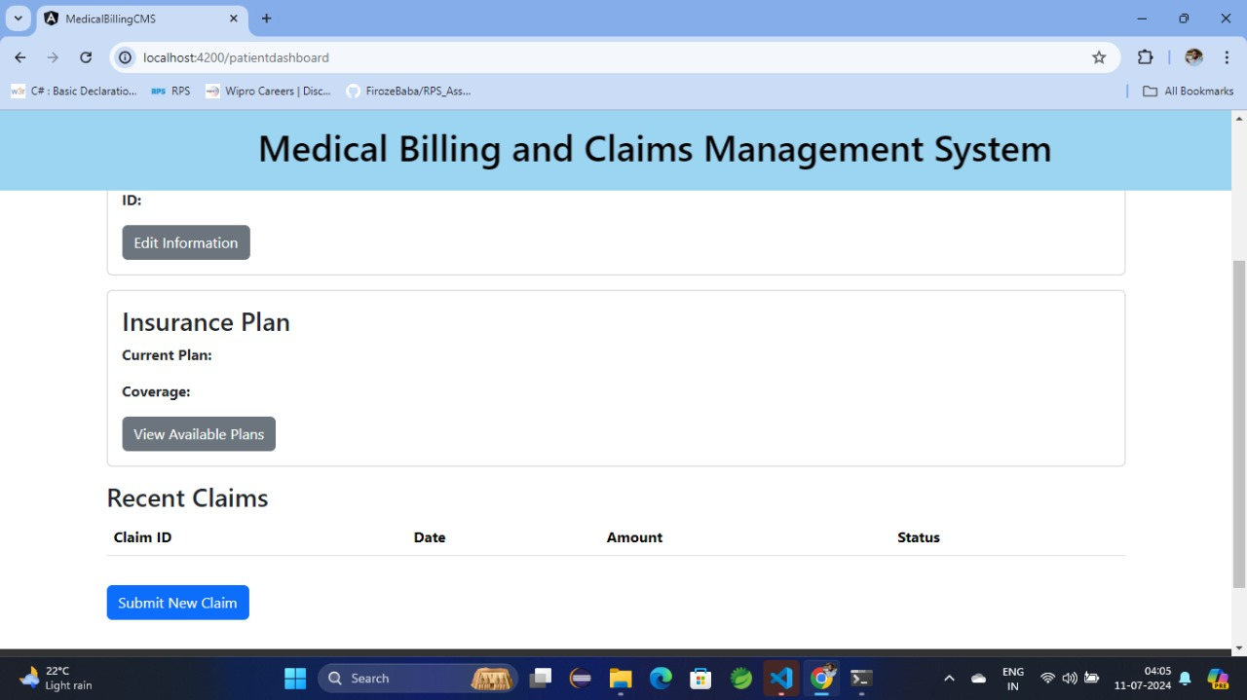
Patient Dashboard
2024 - RPS Consulting all rights reserved

Slide 42
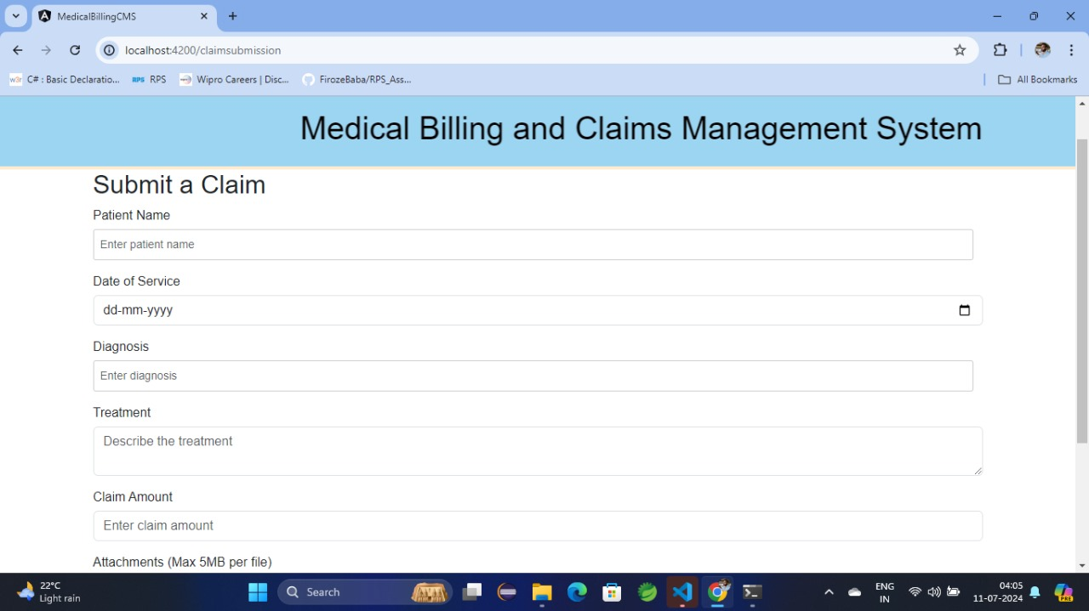
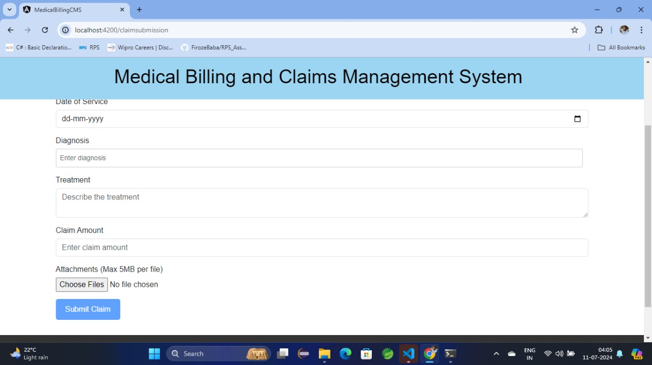
Submit a Claim
2024 - RPS Consulting all rights reserved

Slide 43
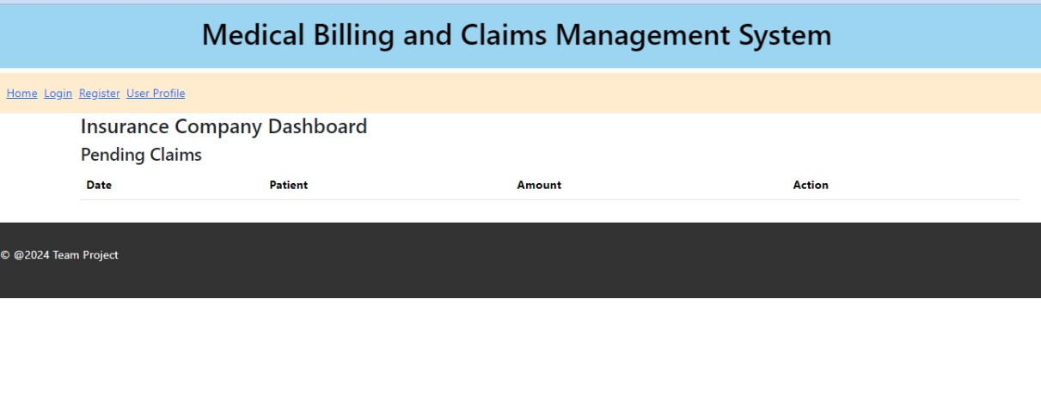
Insurance Company Dashboard
2024 - RPS Consulting all rights reserved

Slide 44
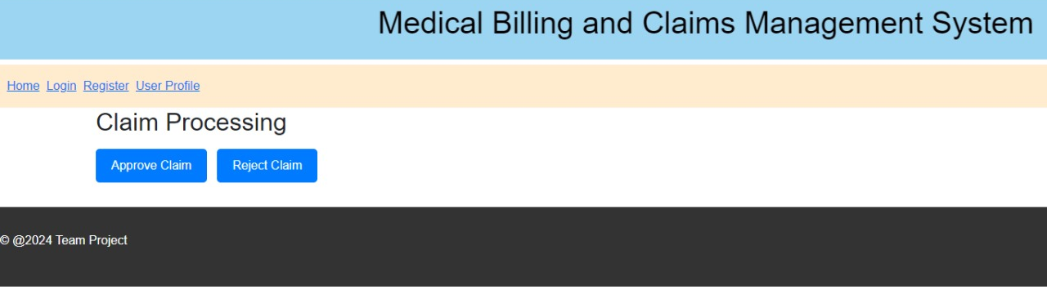
Claim Processing
2024 - RPS Consulting all rights reserved

Slide 45
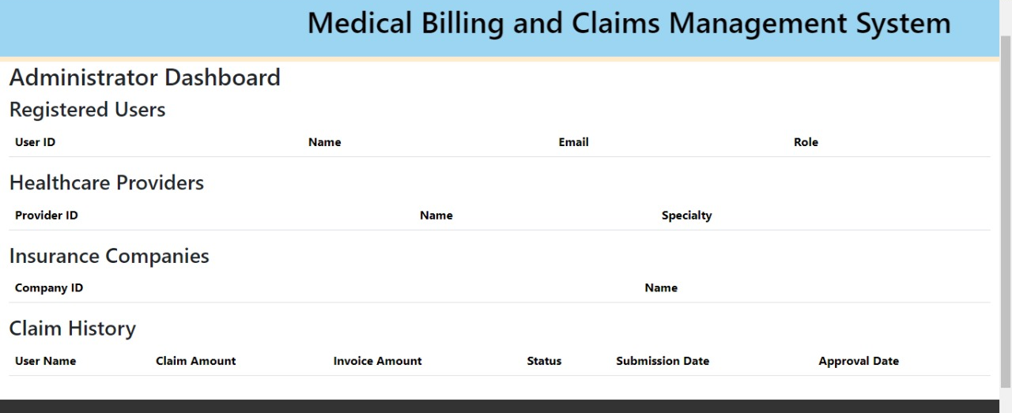
Administrator DashBoard
2024 - RPS Consulting all rights reserved

Slide 46
Conclusion
The CareAssist Medical Billing and Claims Management System successfully streamlines the processes of medical billing, claims submission, and reimbursement. It offers significant benefits:
Efficiency: Reduces administrative burden and speeds up reimbursements.
Accuracy: Minimizes errors through electronic invoicing and claims.
User-Friendly: Provides an intuitive interface for patients, providers, and insurers.
Security: Ensures data privacy with robust authentication and authorization.
Transparency: Enhances oversight with a comprehensive dashboard for administrators.
This system optimizes the billing and claims process, paving the way for future enhancements like EHR integration, AI-driven automation, and a mobile app, contributing to improved healthcare delivery and patient satisfaction.
2024 - RPS Consulting all rights reserved

